Slide 1
CREDIT-CARD SEGMENTATION
Applied Data Science Capstone Project

Slide 2
BUSINESS CONTEXT
Segmentation in marketing is a technique used to divide customers or other entities into groups based on attributes such as behaviour or demographics. It is useful to identify segments of customers who may respond in a similar way to specific marketing techniques such as email subject lines or display advertisements.As it gives businesses the ability to tailor marketing messages and timing to generate better response rates and provide improved consumer experiences.
In this project, the definition of a marketing strategy using a machine learning technique requires the development of a customer segment.
The goal of this analysis report is to discover the Customer Segmentation of a bank, by looking through their behavior/profile while using Credit Card. Hopefully, I can get a clear segmentation of the customer, so I can deploy effective marketing campaign or sales promotion to the targeted costumer.

Slide 3
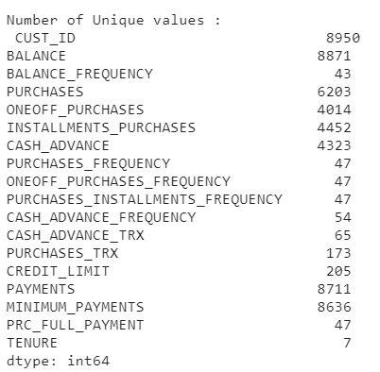
Data acquisition and cleaning
The sample dataset summarizes the usage behavior of about 8000+ active credit card holders during 6 months. The file is at a customer level with 18 behavioral variables.
Number of Unique values:

Slide 4
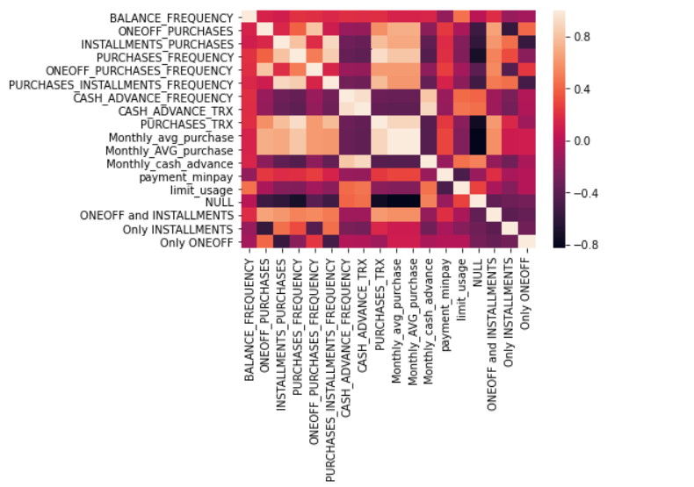
Log-transformation on the dataset to remove outlier effect

Slide 5
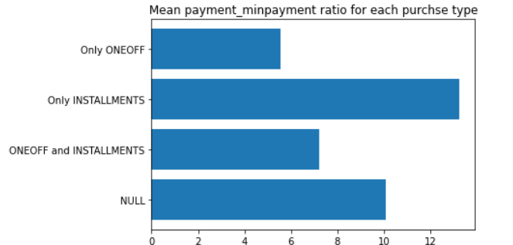
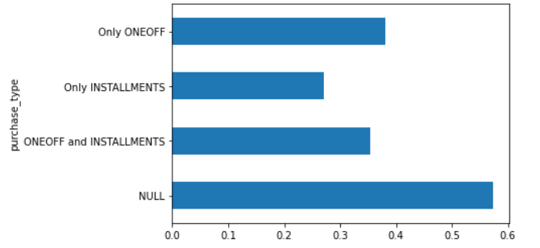
Customer analyse
Average payment_minpayment ratio for each purchse type
Customers who don't do either one-off or installment purchases take more cash on advance

Slide 6
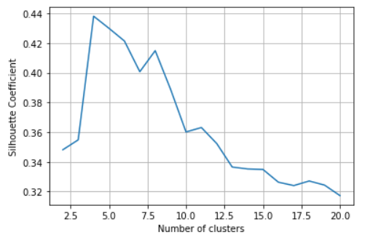
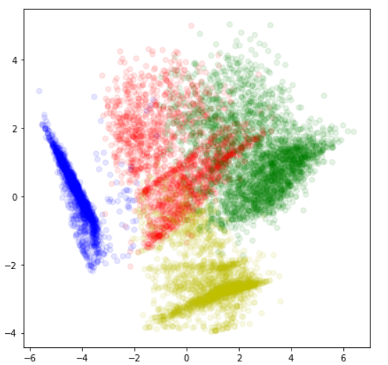
Silhouette Coefficient

Slide 7
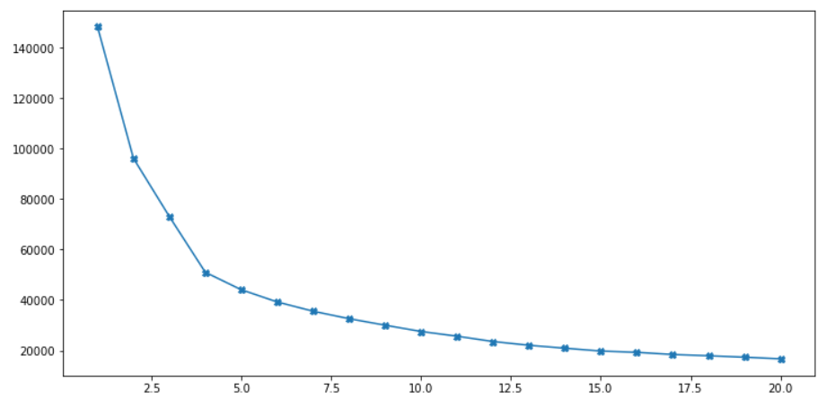
Clustering
Based on the intuition on type of purchases made by customers and their distinctive behavior exhibited based on the purchase_type (as visualized above in Insights from KPI) , I am starting with 4 clusters.
From above graph we will find elbow range. here it is 4,5,6

Slide 8
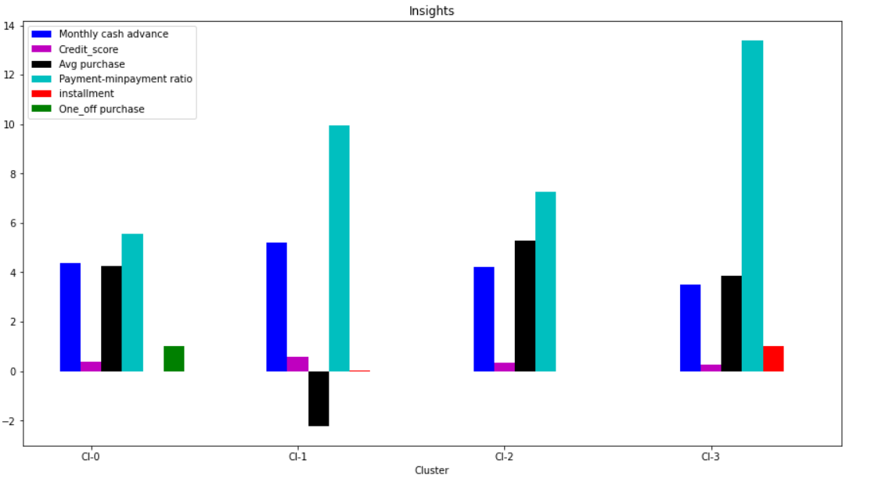
Insights from clusters

Slide 9
Result analyse
Cluster 2 is the group of customers who have highest Monthly_avg purchases and doing both installment as well as one_off purchases, have comparatively good credit score. This group is about 31% of the total customer base
Cluster 1 is taking maximum advance_cash and is paying comparatively less minimum payment and poor credit_score & doing no purchase transaction. This group is about 23% of the total customer base
Cluster 0 customers are doing maximum One_Off transactions and least payment ratio. This group is about 21% of the total customer base
Cluster 3 customers have maximum credit score and are paying dues and are doing maximum installment purchases. This group is about 25% of the total customer base

Slide 10
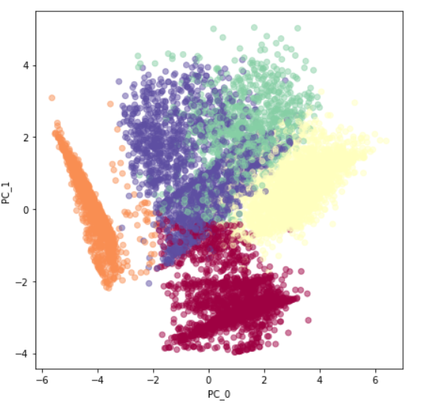
Finding behaviour with 5 Clusters
We have a group of customers (cluster 2) having highest avergae purchases but there is Cluster 4 also having highest cash advance & secong highest purchase behaviour but their type of purchases are same.
Cluster 0 and Cluster 4 are behaving similar in terms of Credit_limit and have cash transactions is on higher side
Conclusion With 5 clusters: So we don't have quite distinguishable characteristics with 5 clusters

Slide 11
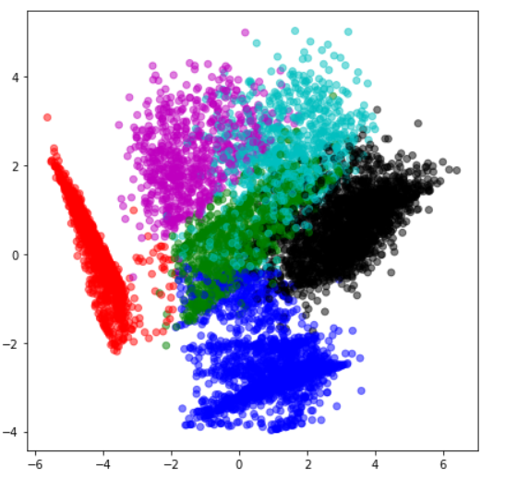
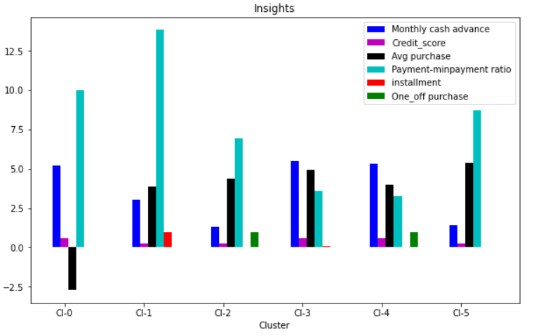
Finding behavior with 6 clusters
Conclusion with 6 clusters:
Here also groups are overlapping.
Cl-0 and Cl-2 behaving same

Slide 12
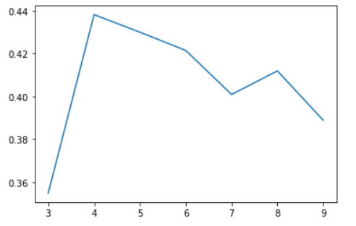
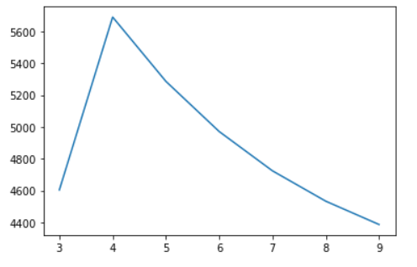
Checking performance metrics for Kmeans
Validating performance with 2 metrics Calinski harabaz and Silhouette score

Slide 13
Results
Cluster 0 customers are doing maximum One_Off transactions and least payment ratio and credit_score on lower side ***This group is about 21% of the total customer base
Cluster 1 is taking maximum advance_cash and is paying comparatively less minimum payment and poor credit_score & doing no purchase transaction. This group is about 23% of the total customer base***
Cluster 2 is the group of customers who have highest Monthly_avg purchases and doing both installment as well as one_off purchases, have comparatively good credit score. This group is about 31% of the total customer base
Cluster 3 customers have maximum credit score and are paying dues and are doing maximum installment purchases.*** This group is about 25% of the total customer base

Slide 14
Suggested Marketing Strategy
Group 0
This group is has minimum paying ratio and using card for just oneoff transactions (may be for utility bills only). This group seems to be risky group.
Group 1
They have poor credit score and taking only cash on advance. We can target them by providing less interest rate on purchase transaction
Group 2
They are potential target customers who are paying dues and doing purchases and maintaining comparatively good credit score )
-- we can increase credit limit or can lower down interest rate
-- Can be given premium card /loyality cards to increase transactions
Group 3
This group is performing best among all as cutomers are maintaining good credit score and paying dues on time.
-- Giving rewards point will make them perform more purchases.

Slide 15
Thanks for watching

